Slide 1
Practice on Essential Enterprise Architecture Tool
001
Opening and Introduction

Slide 2
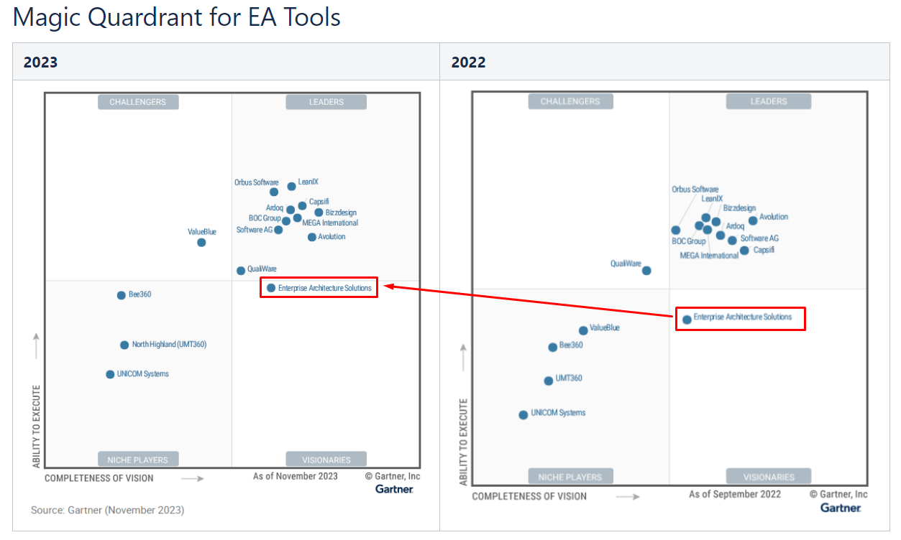
Positioning of Essential

Slide 3

Essential Open-Source Packages Download and Installation
002
https://enterprise-architecture.org/products/essential-open-source/essential-os-download/

Slide 4
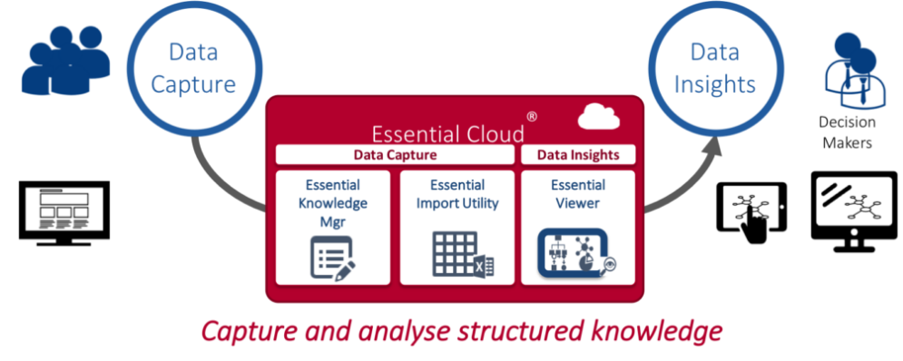
Essential EA Tool (Open-Source) Overview
003
https://enterprise-architecture.org/products/essential-open-source/essential-os-download/

Slide 5
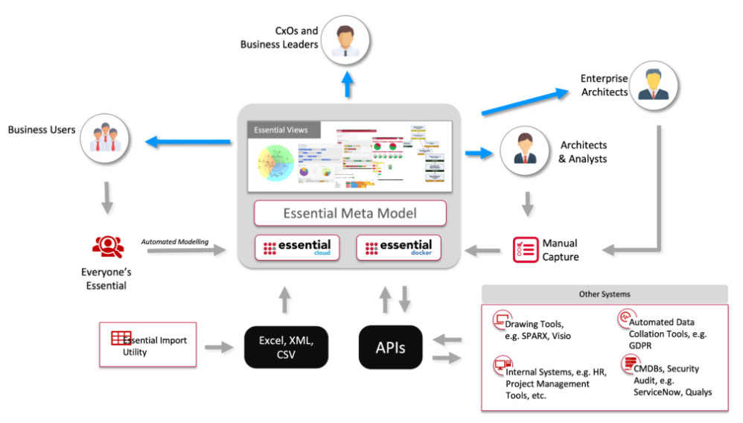
Essential Information Eco System

Slide 6
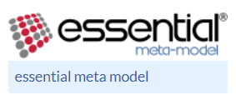
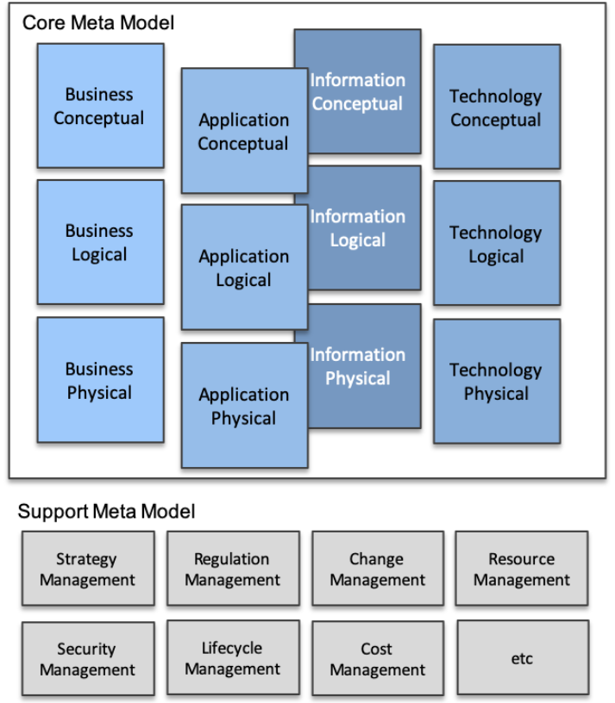
Essential Meta-Model
4 Layers
Business / Application / Information / Technology
3 Views
Conceptual / Logical / Physical
More Supporting areas

Slide 7
Essential Delivery Cycle
Identify stakeholders and concerns
Prioritize delivery
Identify/define the views that will support delivery
(Optional) Identify any meta-model extensions required and the impact on views
Identify the data required, data sources and population method
Plan Training / Consultancy
(Optional) Extend launchpad and build integrations and views as required
Complete Portal and Repository set-up
Capture Data
Embed EA data management process to ensure data is maintained
Measure value

Slide 8

Essential EA Tool – Starting from Business Capability Model
004
https://github.com/yasenstar/EA/tree/master/Essential_EA

Slide 9
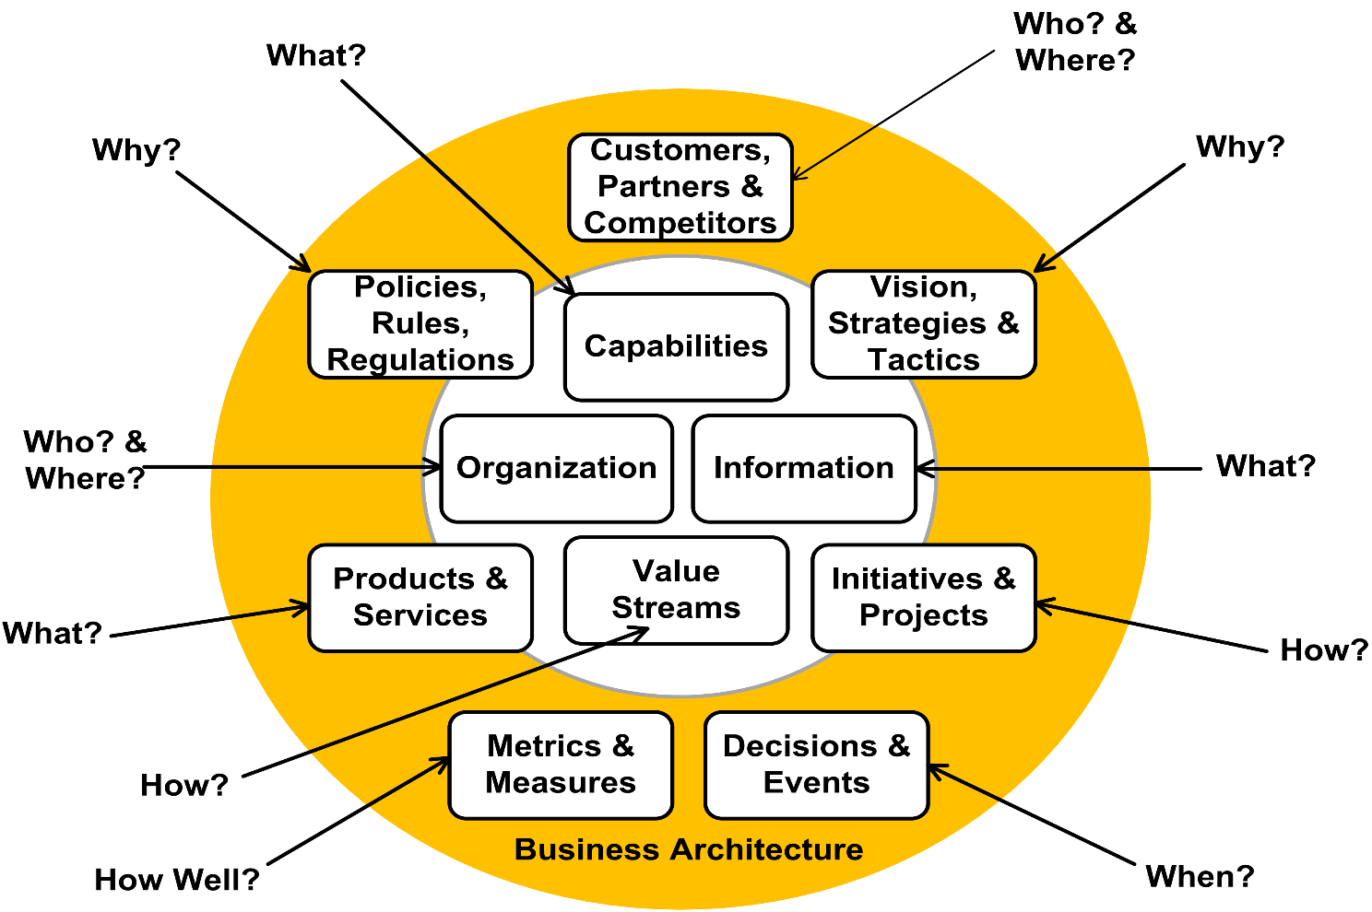
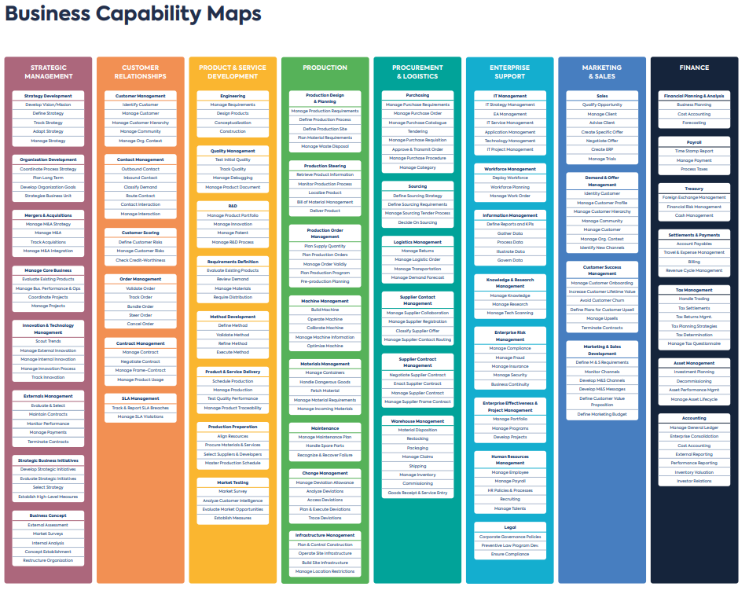
Domains in Business Architecture -- Starting from Defining Business Capability

Slide 10
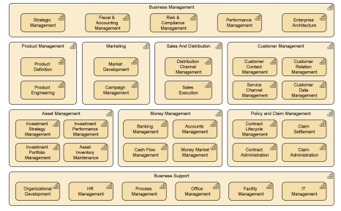
Essential EA Tool –Business Capability Model (Manually Input)
005
https://github.com/yasenstar/EA/tree/master/Essential_EA

Slide 11
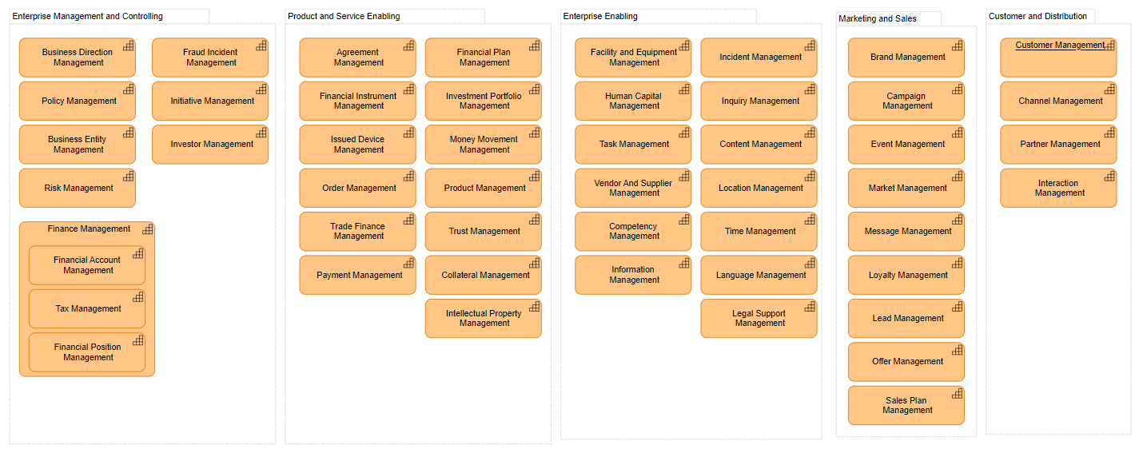
Essential EA Tool – Using Import Utility to Build Business Capability Model
006
https://github.com/yasenstar/EA/tree/master/Essential_EA

Slide 12
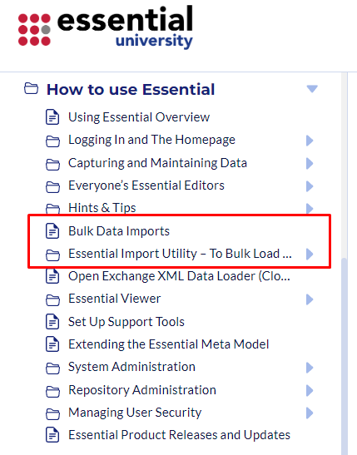
Prerequisites for Performing Imports
Working Essential Open Source (Protégé) Environment
Essential Project Created
Essential Viewer (Dev, QA, Live) Environment -- Webapp
Essential Import Utility – Webapp
Essential Launchpad Import Specification (XML)
https://enterprise-architecture.org/university/bulk-data-imports/
https://enterprise-architecture.org/university/essential-import-utility-to-bulk-load-data/

Slide 13
Setup Import Utility for Launchpad and Import File
Login Import Utility
[Import Setting] Setup Source Repository & Target Environment (Dev/QA/Live)
[Manage Imports] Create Import Activity (Excel) for Source Repository, Enable Log
[Manage Imports] Open Created “Import Activity”
Upload/Edit the Launchpad Import Specification (XML)
(Cloud Only) Preview Source Spreadsheet
Select Worksheets, Make sure only the sheets you want to import are selected
Make sure the sheets’ end rows are set to (at least) the last row of populated data in the related sheet in the Launchpad spreadsheet
Export needed worksheet from Essential Launchpad Exporter
You can test the import first in non-Live environment, this will not update the repository but create the cached version for you to check
If the data looks OK, execute the Import, which will update your Protégé file or generate Import file as DUP
Reference video from Essential: https://www.youtube.com/watch?v=uWIrPJW-LMY

Slide 14
Essential EA Tool – Using Import Utility (Cont.)
007
https://github.com/yasenstar/EA/tree/master/Essential_EA

Slide 15
Some more points
Export latest project file to zip and refresh in Import Activity
Understand system ID is not the frontend ID you imagine in Excel
No need to drag down to get ID, as long as they’re unique, it’s OK!
Verify, verify and verify before import to Production (Live)
If unexpected result happens, try to modify element instead of deleting

Slide 16

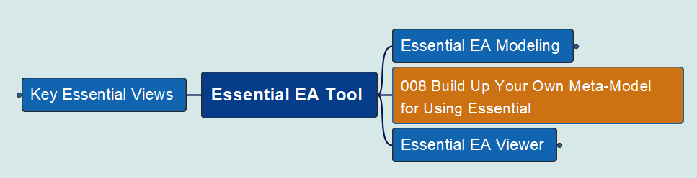
Essential EA Tool – Viewer Build Your Own Meta-Model
008
https://github.com/yasenstar/EA/tree/master/Essential_EA

Slide 17


Essential EA Tool – Viewer Populate Value Stream / Capability Cross-Mapping
009
https://github.com/yasenstar/EA/tree/master/Essential_EA

